Slide 1

Functions & Event Handling
t

Slide 2
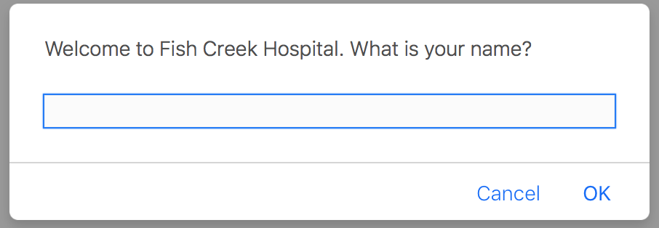
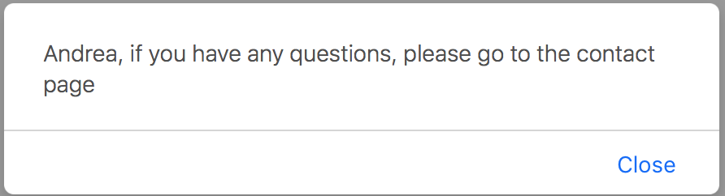
Exercise 1: Reviewing last week’s code
Write the javascript in the Fish Creek website to do the following:

Slide 3
Functions
A function is a defined as a set of statements that takes an input, uses an algorithm, and produces an output

Slide 4
Function Definitions
A function must be defined before it can be used
A function has 2 parts:
Header
Body

Slide 5
Function Calls
After a function is defined it needs to be invoked
Function definitions are usually in the head

Slide 6
I can create my own functions..
<script> //function definition function functionName([param1, param2, param3...]){ ..... ..body goes here .... return something; alert("hello"); //does not execute! } //end of function returnValue = functionName(1,2,3..); //function call <script>

Slide 7
.. and call them within my Javascript code ..
<script> //function definition function functionName([param1, param2, param3...]){ ..... ..body goes here .... return something; alert("hello"); //does not execute! } //end of function returnValue = functionName(1,2,3..); //function call <script>

Slide 8
Or I can call my functions within my HTML code through EVENT HANDLING..
<button onclick="myFunction()">Try it</button>
Notes:
<head>
<script>
function myFunction()
{
alert("Hello World!");
}
</script>

Slide 9
Event Handling

Slide 10
Event Model
Event model is based on interaction between a web surfer and a web page
Events can be classified into two broad groups:
Navigation: clicking on links to browse through web pages
Filling a form: entering data and checking form elements
JavaScript event model is based on event object
event object connects event source to event handler
When an event occurs, JavaScript sends event object to event handler

Slide 11
Events
JavaScript has a unique event for each event source:
Event name Event Source Event handler
abort image onAbort
click checkbox, radio button, onClick
submit button, reset button
& link
change text field/area, list onChange
dragDrop window onDragDrop
error image, window onError
keyDown doc, image, link onKeyDown
keyPress doc, image, link onKeyPress
mouseMove nothing onMouseMove
mouseOut link, image map onMouseOut
mouseOver link, image map onMouseOver
reset reset button form onReset
resize window onResize
submit submit button form onSubmit

Slide 12
Event Handling
Event handler is included as an attribute of a HMTL tag
<a href =“www.neu.edu” onClick =“alert(‘Hello’)”>
Event handlers can be written as:
Inline script: JavaScript code is included inside HTML tag
Function call: event handlers are written as functions in <script> tag and called from the HTML tag

Slide 13
Event Handling
Event handler is included as an attribute of a HMTL tag
<a href =“www.neu.edu” onClick =“alert( alert(‘Hello’)”>
Event handlers can be written as:
Inline script: JavaScript code is included inside HTML tag
Function call: event handlers are written as functions in <script> tag and called from the HTML tag
Event Handlers “glue” HTML
and JavaScript together

Slide 14
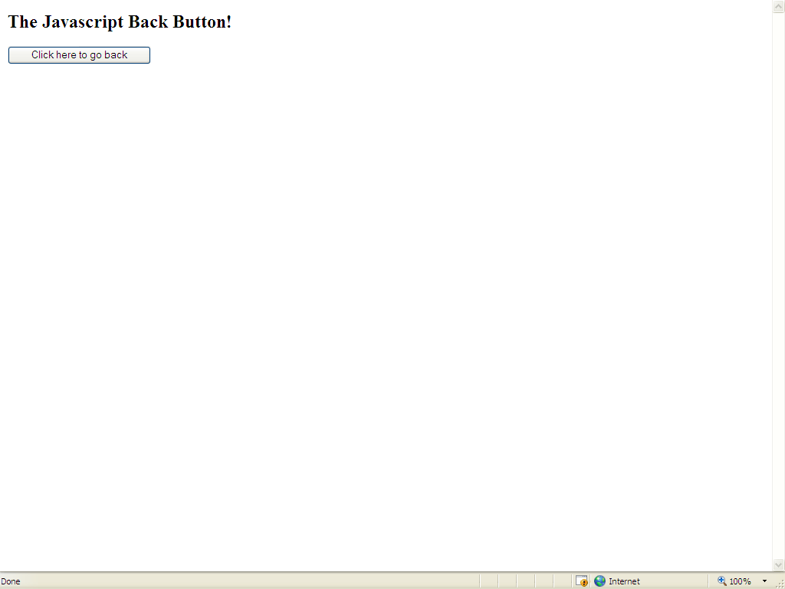
An example (inline) ..
<html>
<head>
<title>JavaScript Example </title>
</head>
<body>
<h2>The Javascript Back Button!</h2>
<form>
<input type="button" name="mybutton1" value="Click here to go back" onClick="history.back()">
</form>
<br>
<br>
</body>
</html>

Slide 15
Another example .. What does it do?
<form> <input type="button" value="Change to Yellow!" name="button3" onClick="document.bgColor='yellow'">
</form>
<a href="noplace" onMouseover="alert('Hey! I said not to try clicking this link!')"> Don't click this link!</a>

Slide 16
Exercise 2: Functions & Event Handling
Put the javascript you wrote in Exercise 1 into a function
Call the function when the page loads
Create a new function that is called if the user hovers on the orange layer.
If a user presses ok on the confirm popup, print out ”You pressed OK”
If a user presses cancel, it prints out ”You pressed CANCEL”

